Slide 1
2nd Trimester Project
This PPT gives examples of what is expected from your project.
It will be due the week we get back from vacation.
Do not forget to do your Greece unit in your NB as well.
The next 2 slides are the handout received in class.

Slide 4
Examples of 2nd trimester work
8 ½ X 11 picture sheet 20 pts.
(min. of 2 pictures)
1 pg. informational paper 100 pts.
Must have 5 W’s
Presentation project 20 pts.
Sky is the limit
Oral presentation (2-4 min.) 20 pts.
160 pts.

Slide 5
Minimum of 2 pictures and the title
Example of 8 1/2X 11 picture sheet

Slide 6
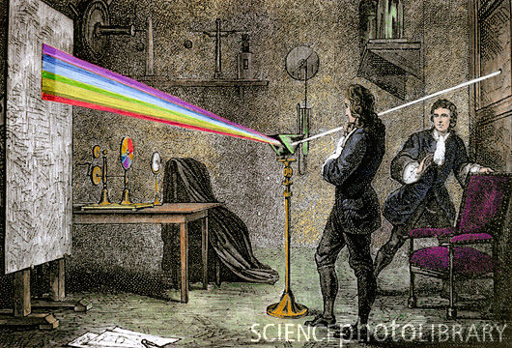
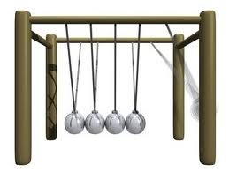
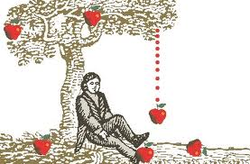
Sir Isaac Newton 1642-1727

Slide 7
Examples of 2nd trimester work
8 ½ X 11 picture sheet 20 pts.
1 pg. informational paper 100 pts.
Presentation project 20 pts.
Oral presentation 20 pts.
160 pts.

Slide 8
5 paragraph informational paper
Example of 1 pg. paper

Slide 9
Informational Paper-100 pts.
Inform me of 5 W’s, possible how
1 pg. paper
Introduction
Main body
Conclusion
Support with facts
Transitional words
No errors

Slide 10
Name
Date
Per.
Title
Paragraph 1-Introduction-------3-5 sentences----------------------------------------------------------------------------------------------------------------------------------------------------------------
Paragraph 2-Main body 1------- 3-5 sentences- ---------------------------------------------------------------------------------------------------------------------------------------------------------------
Paragraph 3-Main body 1---------3-5 sentences- -------------------------------------------------------------------------------------------------------------------------------------------------------------
Paragraph 4-Main body 1-----------3-5 sentences- -----------------------------------------------------------------------------------------------------------------------------------------------------------
Paragraph 5-Conclusion------------ 3-5 sentences- -------------------------------------------------------------------------------------------------------------------------------------------------------------

Slide 11
Examples of 2nd trimester work
8 ½ X 11 picture sheet 20 pts.
1 pg. informational paper 100 pts.
Presentation project 20 pts.
Oral presentation 20 pts.
160 pts.

Slide 12
Sky is the limit
Example of presentation

Slide 13
Poster
Board
8 ½ X 11 Picture Sheet
Picture
Name / Title
Bullet Facts
Picture
Picture

Slide 15
Other forms
Video
Songs
Tri-fold poster board
Sky is the limit

Slide 16
Examples of 2nd trimester work
8 ½ X 11 picture sheet 20 pts.
1 pg. informational paper 100 pts.
Presentation project 20 pts.
Oral presentation 20 pts.
160 pts.

Slide 17
2-4 minutes
Example of oral presentation to class using a Power Point.

Slide 18
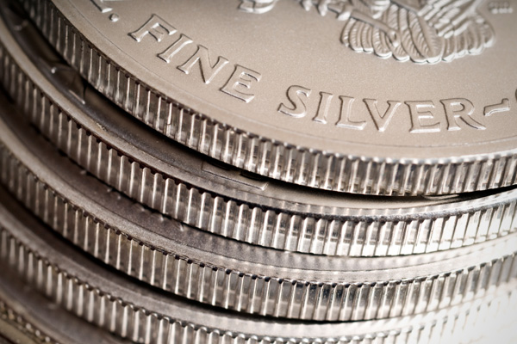
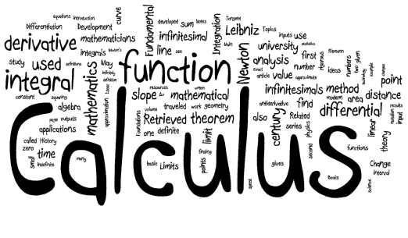
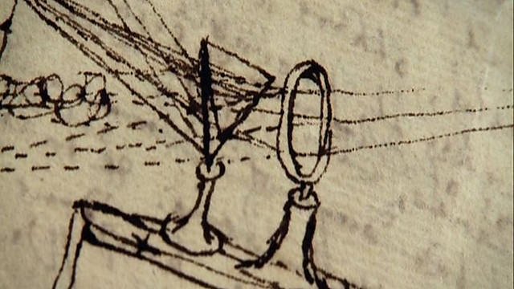
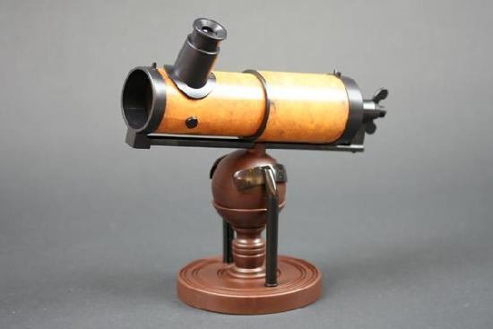
Sir Isaac Newton
By Mr. Jimenez

Slide 19
1642-1727
The high point of the Scientific Revolution was marked by the publication of a remarkable book. This book, published in 1687, was Principia Mathematica.
Came up with the Laws of Motion
An object at rest will remain at rest unless acted on by an unbalanced force.
Acceleration is produced when a force acts on a mass.
For every action there is an equal and opposite re-action.
Created Calculus (study of change)
Put ridges on coins to stop counterfeiters
Was an alchemist (base metals into noble)

Slide 20
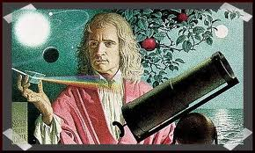
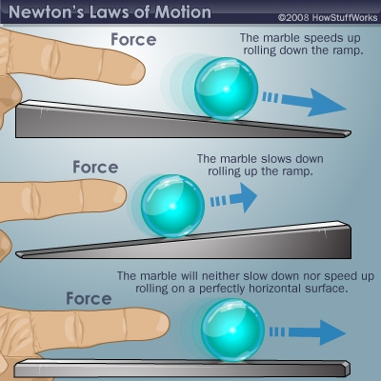
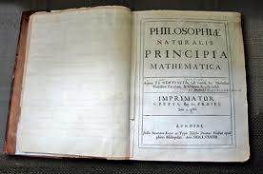

Slide 21
Light
Sir Isaac Newton was interested in learning about the nature of light, so he conducted a series of experiments
Newton proved, however, that light is actually made up of all of the colors of the rainbow.
His research on light became the basis for his invention of the reflecting telescope—the type of telescope found in most large observatories today.

Slide 22
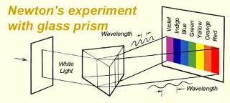
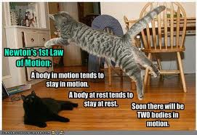
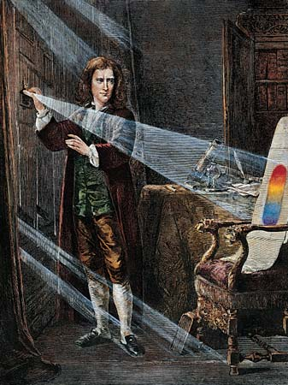
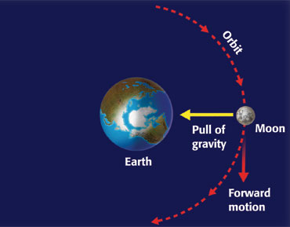
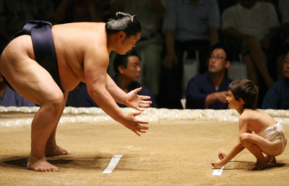
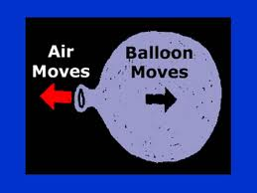

Slide 23
The End

