Slide 1
Section 4
The Yuan and Ming Dynasties
pg180

Slide 2
Key Terms and People
Genghis Khan -Ruler of the Mongols, he led his people in attacks against China and against other parts of Asia. His name means "universal leader."
Kublai Khan -Mongol ruler, he completed the conquest of China and founded the Yuan dynasty.
Zheng He -Chinese admiral during the Ming Dynasty, he led great voyages that spread China’s fame throughout Asia.
Isolationism -a policy of avoiding contact with other countries

Slide 3
The Chinese were ruled by foreigners during the Yuan dynasty, but they threw off Mongol rule and prospered during the Ming dynasty.
1. The Mongol Empire included China, and the Mongols ruled China as the Yuan dynasty.
2. The Ming dynasty was a time of stability and prosperity.
3. China under the Ming saw great changes in its government and relations with other countries.

Slide 4
If YOU were there...
You are a farmer in northern China in 1212. As you pull weeds from a wheat field, you hear a sound like thunder. Looking toward the sound, you see hundreds—no, thousands—of armed horsemen on the horizon, riding straight toward you. You are frozen with fear. Only one thought fills your mind—the dreaded Mongols are coming.
What can you do to save yourself?

Slide 5
BUILDING BACKGROUND
Throughout its history, northern China had been attacked over and over by nomadic peoples. During the Song dynasty these attacks became more frequent and threatening.

Slide 6
The Mongol Empire
Among the nomadic peoples who attacked the Chinese were the Mongols. For centuries, the Mongols had lived as separate tribes in the vast plains north of China. Then in 1206, a powerful leader, or khan, united them. His name was Temüjin. When he became leader, though, he was given a new title: “Universal Ruler,” or Genghis Khan (JENG-guhs KAHN).

Slide 7
The Mongol Conquest
Genghis Khan organized the Mongols into a powerful army and led them on bloody expeditions of conquest. The brutality of the Mongol attacks terrorized people throughout much of Asia and Eastern Europe. Genghis Khan and his army killed all of the men, women, and children in countless cities and villages. Within 20 years, he ruled a large part of Asia.

Slide 8
Genghis Khan then turned his attention to China. He first led his armies into northern China in 1211. They fought their way south, wrecking whole towns and ruining farmland. By the time of Genghis Khan's death in 1227, all of northern China was under Mongol control.

Slide 9
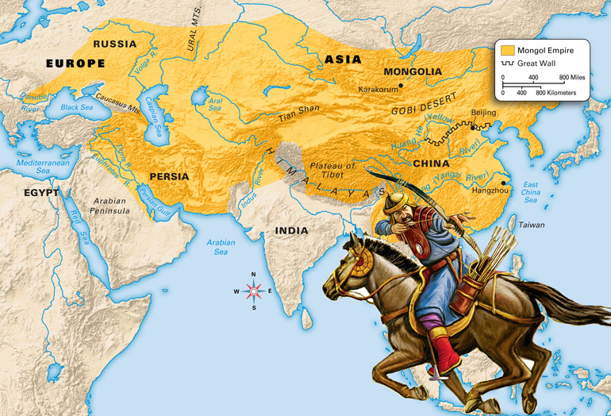
1294

Slide 10
The Mongol conquests did not end with Genghis Khan's death, though. His sons and grandsons continued to raid lands all over Asia and Eastern Europe. The destruction the Mongols left behind was terrible, as one Russian chronicler noted:
“There used to be the city of Riazan in the land of Riazan, but its wealth and glory ceased, and there is nothing to be seen in the city excepting smoke, ashes, and barren earth.”
–from “The Tale of the Destruction of Riazan,” in Medieval Russia's Epics, Chronicles, and Tales, edited by Serge Zenkovsky

Slide 11
In 1260 Genghis Khan's grandson Kublai Khan (KOO-bluh KAHN) became ruler of the Mongol Empire. He completed the conquest of China and in 1279 declared himself emperor of China. This began the Yuan dynasty, a period that some people also call the Mongol Ascendancy. For the first time in its long history, foreigners ruled all of China.

Slide 12
Life in Yuan China
Kublai Khan and the Mongol rulers he led belonged to a different ethnic group than the Chinese did. They spoke a different language, worshipped different gods, wore different clothing, and had different customs. The Chinese resented being ruled by these foreigners, whom they saw as rude and uncivilized.

Slide 13
However, Kublai Khan did not force the Chinese to accept Mongol ways of life. Some Mongols even adopted aspects of the Chinese culture, such as Confucianism. Still, the Mongols made sure to keep control of the Chinese. They prohibited Confucian scholars from gaining too much power in the government, for example. The Mongols also placed heavy taxes on the Chinese.

Slide 14
Much of the tax money the Mongols collected went to pay for vast public-works projects. These projects required the labor of many Chinese people. The Yuan extended the Grand Canal and built new roads and palaces. Workers also improved the roads that were part of China's postal system. In addition, the Yuan emperors built a new capital, Dadu, near modern Beijing.

Slide 15
Mongol soldiers were sent throughout China to keep the peace as well as to keep a close watch on the Chinese. The soldiers' presence kept overland trade routes safe for merchants. Sea trade between China, India, and Southeast Asia continued, too. The Mongol emperors also welcomed foreign traders at Chinese ports. Some of these traders received special privileges.

Slide 16
Part of what we know about life in the Yuan dynasty comes from one such trader, an Italian merchant named Marco Polo. Between 1271 and 1295 he traveled in and around China. Polo was highly respected by the Mongols and even served in Kublai Khan's court. When Polo returned to Europe, he wrote of his travels. Polo's descriptions of China fascinated many Europeans. His book sparked much European interest in China.

Slide 17
The End of the Yuan Dynasty
Despite their vast empire, the Mongols were not content with their lands. They decided to invade Japan. A Mongol army sailed to Japan in 1274 and 1281. The campaigns, however, were disastrous. Violent storms and fierce defenders destroyed most of the Mongol force.

Slide 18
The failed campaigns against Japan weakened the Mongol military. The huge, expensive public-works projects had already weakened the economy. These weaknesses, combined with Chinese resentment, made China ripe for rebellion.
In the 1300s many Chinese groups rebelled against the Yuan dynasty. In 1368 a former monk named Zhu Yuanzhang (JOO yoo-ahn-JAHNG) took charge of a rebel army. He led this army in a final victory over the Mongols. China was once again ruled by the Chinese.

Slide 19
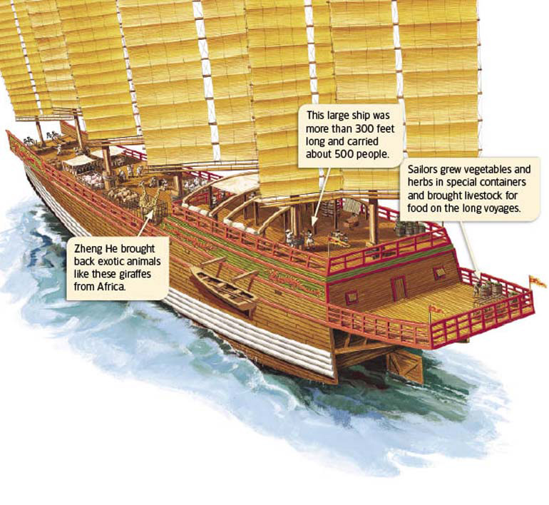
ANALYZING VISUALS
How did Zheng He's crew make sure they had fresh food?
 |  |  |  |  | Path:
 | The Ming Dynasty After his army defeated the Mongols, Zhu Yuanzhang became emperor of China. The Ming dynasty that he founded ruled China from 1368 to 1644—nearly 300 years. Ming China proved to be one of the most stable and prosperous times in Chinese history. The Ming expanded China's fame overseas and sponsored incredible building projects across China. Great Sea Voyages During the Ming dynasty, the Chinese improved their ships and their sailing skills. The greatest sailor of the period was Zheng He (juhng HUH). Between 1405 and 1433, he led seven grand voyages to places around Asia. Zheng He's fleets were huge. One included more than 60 ships and 25,000 sailors. Some of the ships were gigantic too, perhaps more than 300 feet long. That is longer than a football field! In the course of his voyages Zheng He sailed his fleet throughout the Indian Ocean. He sailed as far west as the Persian Gulf and the easternmost coast of Africa.
Copyright © by Holt, Rinehart and Winston. All rights reserved. Terms of Use. Credits. Privacy Policy.

Slide 20
The Ming Dynasty
After his army defeated the Mongols, Zhu Yuanzhang became emperor of China. The Ming dynasty that he founded ruled China from 1368 to 1644—nearly 300 years. Ming China proved to be one of the most stable and prosperous times in Chinese history. The Ming expanded China's fame overseas and sponsored incredible building projects across China.

Slide 21
Great Sea Voyages
During the Ming dynasty, the Chinese improved their ships and their sailing skills. The greatest sailor of the period was Zheng He (juhng HUH). Between 1405 and 1433, he led seven grand voyages to places around Asia. Zheng He's fleets were huge. One included more than 60 ships and 25,000 sailors. Some of the ships were gigantic too, perhaps more than 300 feet long. That is longer than a football field!
In the course of his voyages Zheng He sailed his fleet throughout the Indian Ocean. He sailed as far west as the Persian Gulf and the easternmost coast of Africa.

Slide 22
Everywhere his ships landed, Zheng He presented leaders with beautiful gifts from China. He boasted about his country and encouraged foreign leaders to send gifts to China's emperor. From one voyage, Zheng He returned to China with representatives of some 30 nations, sent by their leaders to honor the emperor. He also brought goods and stories back to China.
Zheng He's voyages rank among the most impressive in the history of seafaring. Although they did not lead to the creation of new trade routes or the exploration of new lands, they served as a clear sign of China's power.

Slide 23
Great Building Projects
The Ming were also known for their grand building projects. Many of these projects were designed to impress both the Chinese people and their enemies to the north.

Slide 24
In Beijing, for example, Ming emperors built the Forbidden City. This amazing palace complex included hundreds of imperial residences, temples, and other government buildings. Within the buildings were some 9,000 rooms. The name “Forbidden City” came from the fact that the common people were not even allowed to enter the complex. For centuries, this city within a city was a symbol of China's glory.

Slide 25
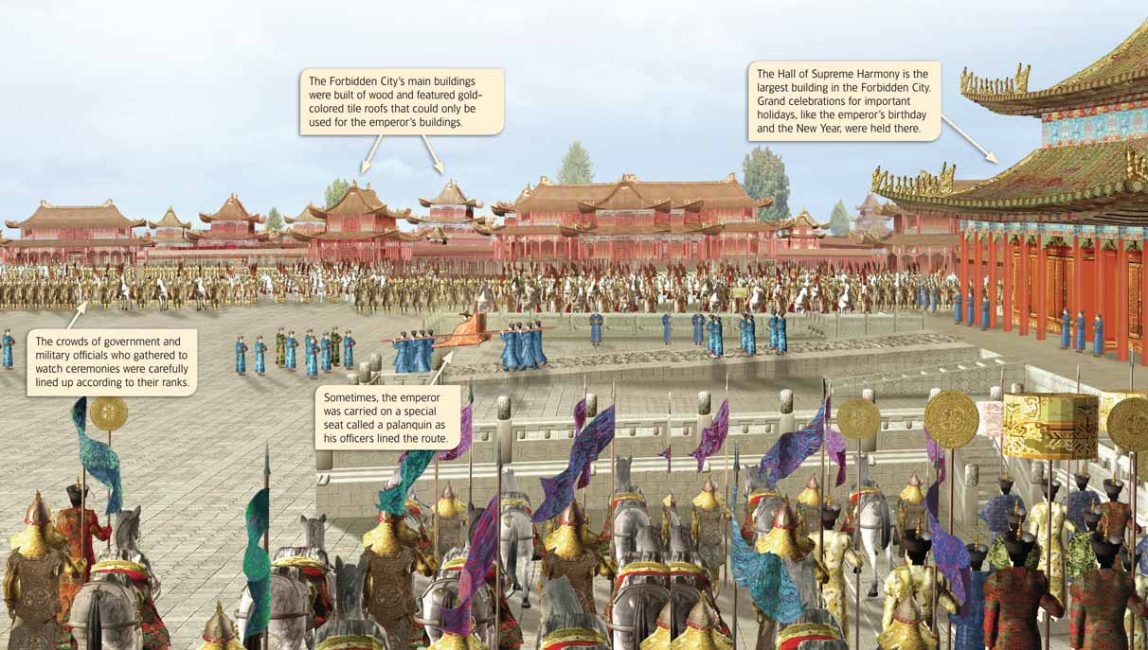
ANALYZING VISUALS
How did the Forbidden City show the power and importance of the emperor?
 |  |  |  |  | Path:

Slide 26
Ming rulers also directed the restoration of the famous Great Wall of China. Large numbers of soldiers and peasants worked to rebuild collapsed portions of walls, connect existing walls, and build new ones. The result was a construction feat unmatched in history. The wall was more than 2,000 miles long. It would reach from San Diego to New York! The wall was about 25 feet high and, at the top, 12 feet wide. Protected by the wall—and the soldiers who stood guard along it—the Chinese people felt safe from invasions by the northern tribes.

Slide 27
China Under the Ming
During the Ming dynasty, Chinese society began to change. This change was largely due to the efforts of the Ming emperors. Having expelled the Mongols, the Ming emperors worked to eliminate all foreign influences from Chinese society. As a result, China's government and relations with other countries changed dramatically.

Slide 28
Government
When the Ming took over China, they adopted many government programs that had been created by the Tang and the Song. However, the Ming emperors were much more powerful than the Tang and Song emperors had been. They abolished the offices of some powerful officials and took a larger role in running the government themselves. These emperors fiercely protected their power, and they punished anyone whom they saw as challenging their authority.

Slide 29
Despite their personal power, though, the Ming did not disband the civil service system. Because he personally oversaw the entire government, the emperor needed officials to keep his affairs organized.
The Ming also used examinations to appoint censors. These officials were sent throughout China to investigate the behavior of local leaders and to judge the quality of schools and other institutions. Censors had existed for many years in China, but under the Ming their power and influence grew.

Slide 30
Relations with Other Countries
In the 1430s a new Ming emperor made Zheng He return to China and dismantle his fleet. At the same time, he banned foreign trade. China entered a period of isolationism. Isolationism is a policy of avoiding contact with other countries.
In the end, this isolationism had great consequences for China. In 1644 the Ming dynasty was overthrown. By the late 1800s the Western world had made huge leaps in technological progress. Westerners were then able to gain influence in Chinese affairs. Partly due to its isolation and lack of progress, China was too weak to stop them.

Slide 31
SUMMARY AND PREVIEW
Under the Yuan and Ming dynasties, Chinese society changed. Eventually, the Ming began a policy of isolationism. In the next chapter you will read about Japan, another country that was isolated at times.

Slide 32
Section 4 G.O. History notebook pg 43
Identify key facts about China under the Yuan and Ming dynasties.

