Slide 1
How to upload a file from Mr. Jimenez’s website
Follow the next 10 steps in order to upload any file to me.

Slide 2
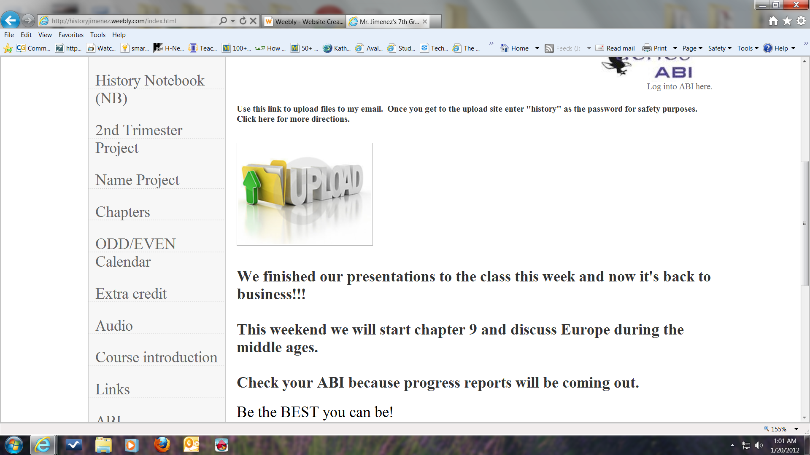
1st click on this image

Slide 3
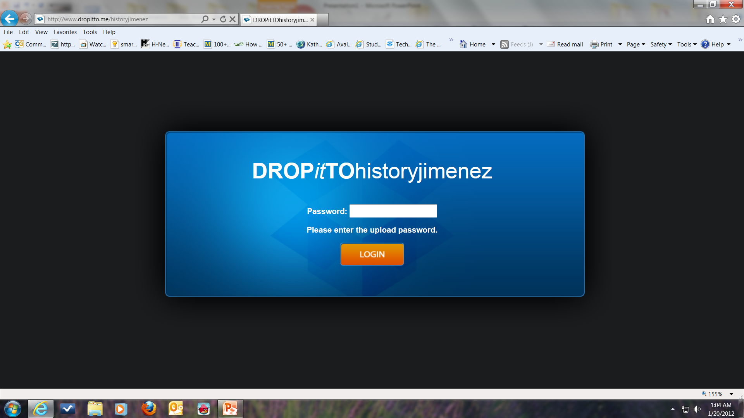
2nd- enter in history as the password.

Slide 4
3rd- click login

Slide 5
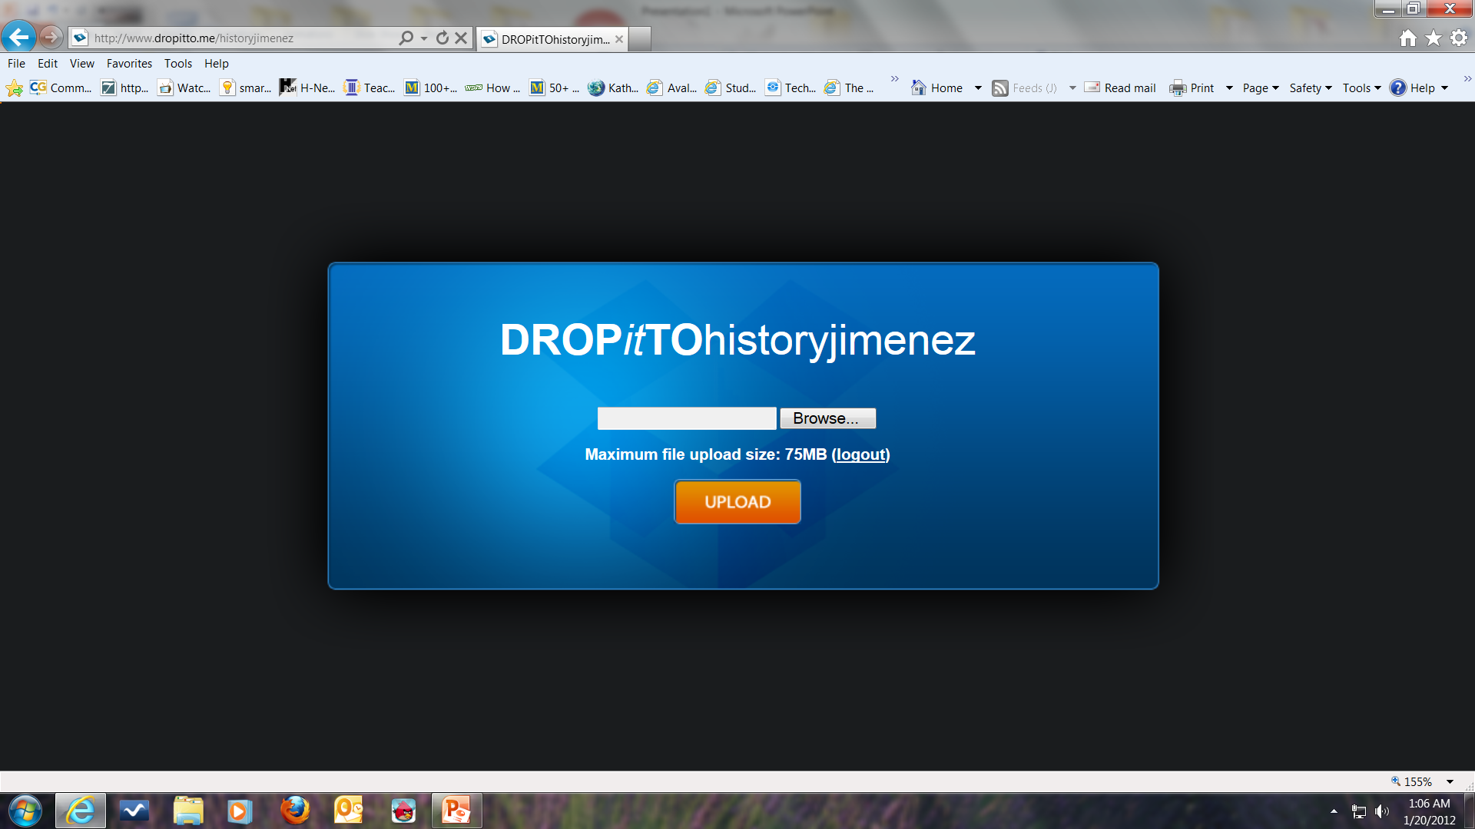
4th- click the Browse button to find the file you want to upload to me.

Slide 6
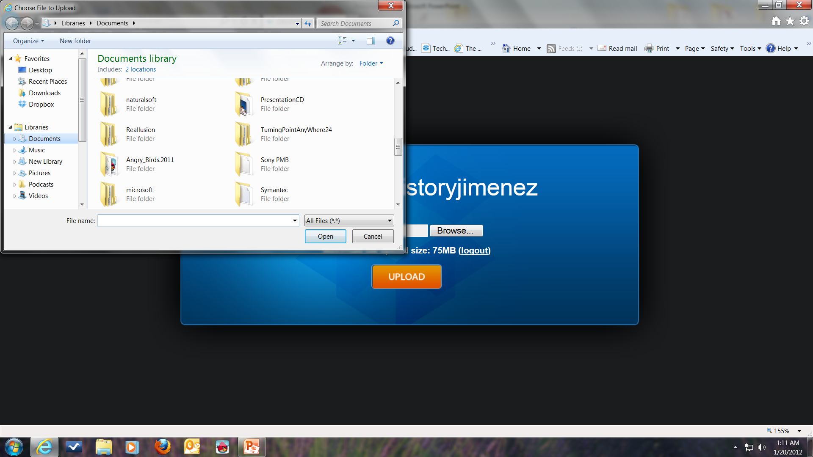
5th- choose the location where the file is stored.

Slide 7
6th- once the file is found, double click it to add it. It should be in the box.

Slide 8
7th- click upload to send the file.

Slide 9
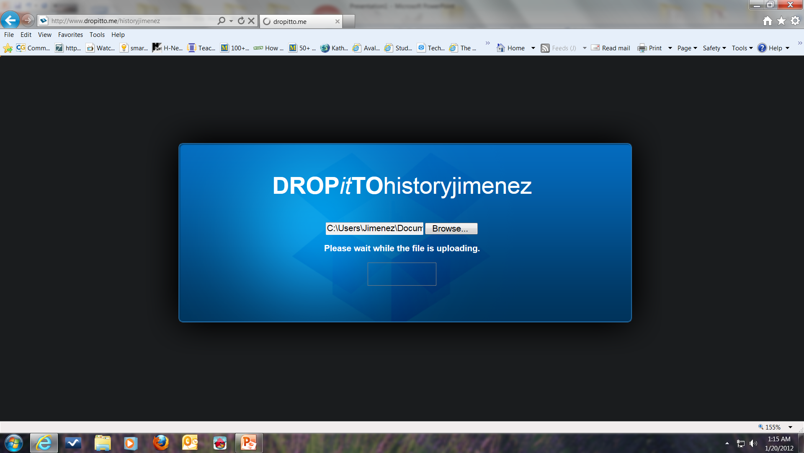
8th- you should immediately get this message while it uploads the file.

Slide 10
9th- once it has uploaded, you will get this message.

Slide 11
10th- you are now done, you may close the windows.

