Slide 1
5 min warm up
1) Who was the Emperor that split up the Roman Empire?
2) Atila was the leader of what barbarian group?

Slide 2
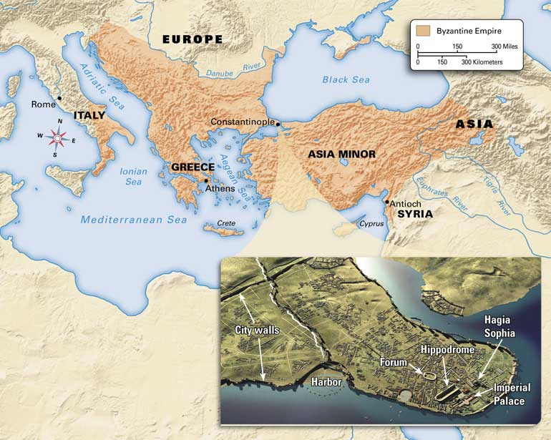
Section 3
The Byzantine Empire
Pg 36

Slide 3
If YOU were there...
You are a trader visiting Constantinople. You have traveled to many cities but have never seen anything so magnificent. The city has huge palaces and stadiums for horse races. In the city center you enter a church and stop, speechless with amazement. Above you is a vast, gold dome lit by hundreds of candles.
How does the city make you feel about its rulers?

Slide 4
BUILDING BACKGROUND
Even before the western empire fell to the Goths, power had begun to shift to the richer, more stable east. The people of the eastern empire considered themselves Romans, but their culture was very different from that of Rome itself.

Slide 5
Key Terms and People
Section 3
Justinian
Theodora
Byzantine Empire
mosaics

Slide 6
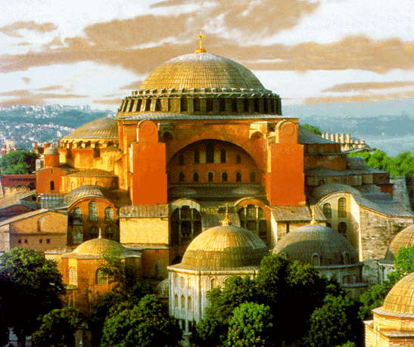
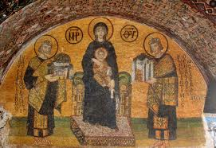
Justinian:
(juh-STIN-ee-uhn) (c. 483–565) Byzantine emperor, he reunited the Roman Empire, simplified Roman laws with Justinian’s Code, and ordered Hagia Sophia built.

Slide 7
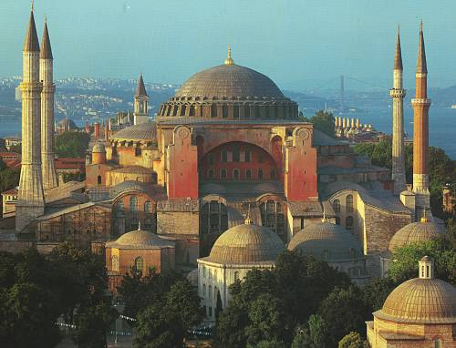
What is the difference?

Slide 8
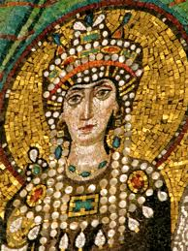
Theodora:
(thee-uh-DOHR-uh) (c. 500–548) Wife of the Byzantine emperor Justinian, she was a smart and powerful woman who helped him rule effectively.

Slide 9
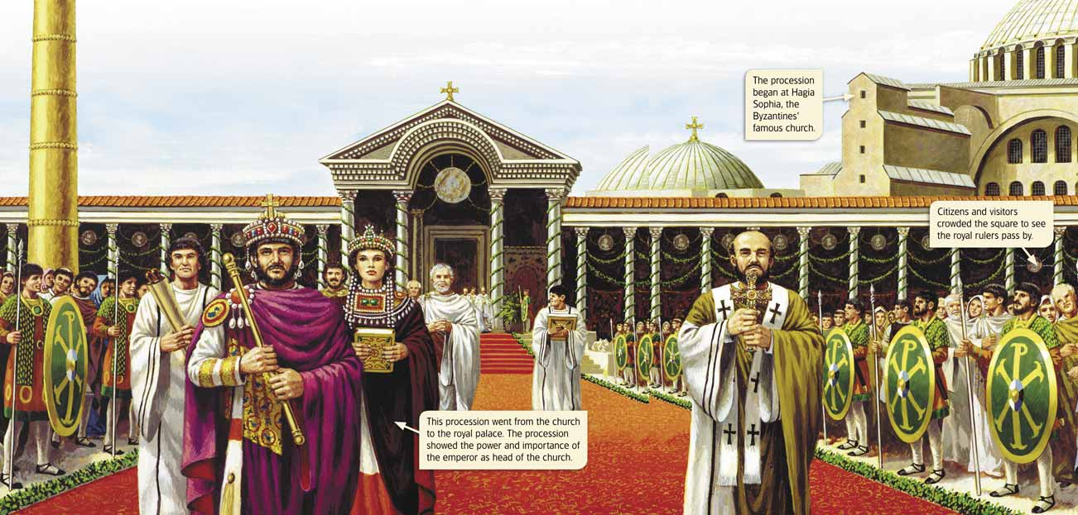

Slide 10
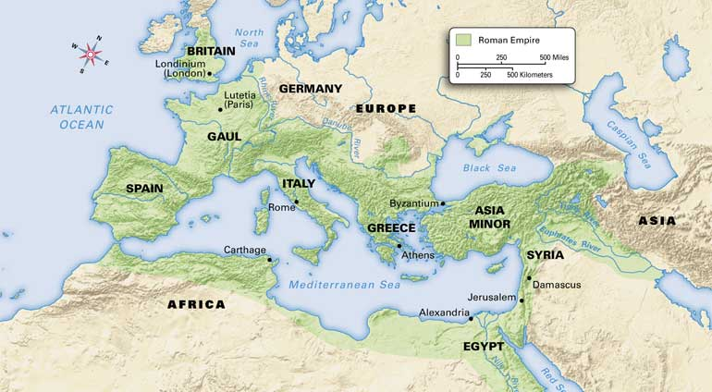
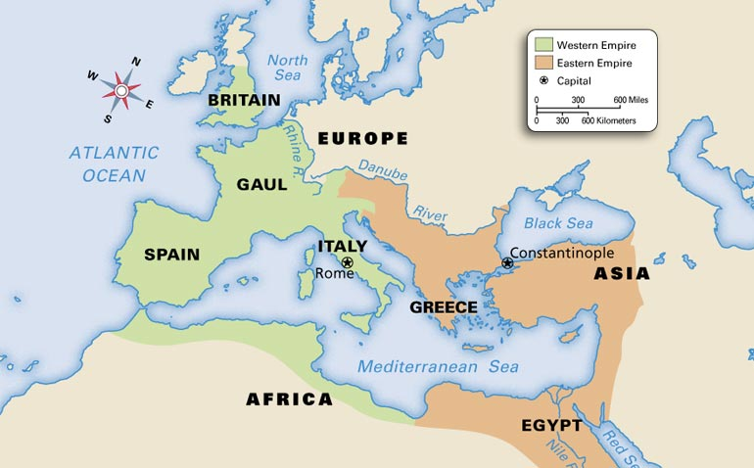
The Same city

Slide 11
Byzantine Empire
the society that developed in the eastern Roman Empire after the fall of the western Roman Empire

Slide 12
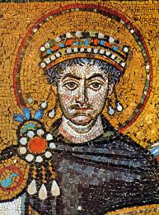
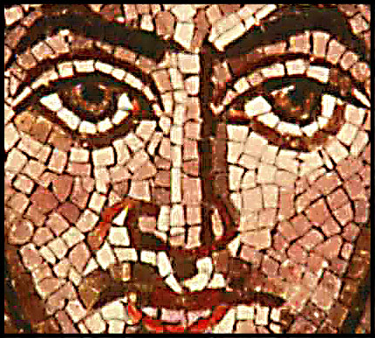
mosaic
a picture made with pieces of colored stone or glass

Slide 13
B.T.E.O.T.Y.W.B.A.T. by the end of today, you will be able to……
Describe how the Eastern Roman Empire was Different than the Western Roman Empire.

Slide 14
Main Ideas
1.Eastern emperors ruled from Constantinople and tried but failed to reunite the whole Roman Empire.
2.The people of the eastern empire created a new society that was very different from society in the west.
3.Byzantine Christianity was different from religion in the west.

Slide 15
Emperors Rule from Constantinople
Constantinople was built on the site of an ancient Greek trading city called Byzantium (buh-ZAN-shuhm). It lay near both the Black Sea and the Mediterranean Sea. This location between two seas protected the city from attack and let the city control trade between Europe and Asia. Constantinople was in an ideal place to grow in wealth and power.

Slide 16
Justinian
After Rome fell in 476, the emperors of the eastern Roman Empire dreamed of taking it back and reuniting the old Roman Empire. For Justinian (juh-STIN-ee-uhn), an emperor who ruled from 527 to 565, reuniting the empire was a passion. He couldn’t live with a Roman Empire that didn’t include the city of Rome, so he sent his army to retake Italy. In the end this army conquered not only Italy but also much land around the Mediterranean. Justinian’s other passions were the law and the church. He ordered officials to examine all of Rome’s laws and remove any out-of-date or unchristian laws.

Slide 17
Cont.
He then organized all the laws into a legal system called Justinian’s Code. By simplifying Roman law, this code helped guarantee fair treatment for all. Despite his achievements, Justinian made many enemies. Two groups of these enemies joined together and tried to overthrow him in 532. These groups led riots in the streets and set fire to buildings. Scared for his life, Justinian prepared to leave Constantinople.
Justinian was stopped from leaving by his wife, Theodora (thee-uh-DOHR-uh). She convinced Justinian to stay in the city. Smart and powerful, Theodora helped her husband rule effectively. With her advice, he found a way to end the riots. Justinian’s soldiers killed all the rioters—some 30,000 people—and saved the emperor’s throne.

Slide 19
The Empire after Justinian
After the death of Justinian in 565, the eastern empire began to decline. Faced with invasions by barbarians, Persians, and Muslims, later emperors lost all the land Justinian had gained. The eastern empire remained a major power for several hundred years, but it never regained its former strength.
The eastern empire’s struggles finally ended nearly 700 years after the death of Justinian. In 1453 a group called the Ottoman Turks captured Constantinople. With this defeat the 1,000-year history of the eastern Roman Empire came to an end.

Slide 20
A New Society
In many ways Justinian was the last Roman emperor of the eastern empire. After he died, non-Roman influences took hold throughout the empire. People began to speak Greek, the language of the eastern empire, rather than Latin. Scholars studied Greek, not Roman, philosophy. Gradually, the empire lost its ties to the old Roman Empire, and a new society developed.
The people who lived in this society never stopped thinking of themselves as Romans. But modern historians have given their society a new name. They call the society that developed in the eastern Roman Empire after the west fell the Byzantine (BI-zuhn-teen) Empire, named after the Greek town of Byzantium.

Slide 21
Outside Influence
One reason eastern and western Roman society was different was the Byzantines’ interaction with other groups. This interaction was largely a result of trade. Because Constantinople’s location was ideal for trading between Europe and Asia, it became the greatest trading city in Europe.
Merchants from all around Europe, Asia, and Africa traveled to Constantinople to trade. Over time Byzantine society began to reflect these outside influences as well as its Roman and Greek roots.

Slide 22
Government
The forms of government that developed in the eastern and western empires also created differences. Byzantine emperors had more power than western emperors did.
They liked to show off their great power. For example, people could not stand while they were in the presence of the eastern emperor. They had to crawl on their hands and knees to talk to him.
The power of an eastern emperor was greater, in part, because the emperor was considered the head of the church as well as the political ruler. The Byzantines thought the emperor had been chosen by God to lead both the empire and the church. In the west the emperor was limited to political power. Popes and bishops were the leaders of the church.

Slide 23
Byzantine Christianity
Byzantine Christianity
Just as it was in the west, Christianity was central to the Byzantines’ lives. From the beginning, nearly everyone who lived in the Byzantine Empire was Christian.
To show their devotion to God and the Christian Church, Byzantine artists created beautiful works of religious art. Among the grandest works were mosaics, pictures made with pieces of colored stone or glass. Some mosaics sparkled with gold, silver, and jewels.

Slide 24
Cont.
Even more magnificent than their mosaics were Byzantine churches, especially Hagia Sophia (HAH-juh soh-FEE-uh). Built by Justinian in the 530s, its huge domes rose high above Constantinople. According to legend, when Justinian saw the church he exclaimed in delight
“Glory to God who has judged me worthy of accomplishing such a work as this! O Solomon, I have outdone you!”
–Justinian, quoted in The Story of the Building of the Church of Santa Sophia

Slide 25
Cont.
As time passed, people in the east and west began to interpret and practice Christianity differently. For example, eastern priests could get married, while priests in the west could not. Religious services were performed in Greek in the east. In the west they were held in Latin.
For hundreds of years, church leaders from the east and west worked together peacefully despite their differences. However, the differences between their ideas continued to grow. In time the differences led to a split within the Christian Church. In the 1000s Christians in the east broke away from the rest of the church and formed what became known as the Eastern Orthodox Church. As a result, eastern and western Europe were completely divided

Slide 26
SUMMARY AND PREVIEW
The Roman Empire and the Christian Church both divided into two parts. The Eastern Orthodox Church became a major force in the Byzantine Empire. Before long, though, Orthodox Christians encountered members of a religious group they had never met before, the Muslims.

Slide 27
List what is different and what is the same with the two empires.
Western Roman Empire
Eastern Roman Empire

Slide 29
Chapter 2 section 3 G.O.
-Spoke latin
-lived in Rome
-Popes, bishops ran the church
-Emperor led
Government
-Christianity
-once part of
Rome
-Roman Laws
-Emperors led
the church
-Spoke Greek
-Lived in Constantinople
Western
Roman
Empire
Eastern
Roman
Empire

