Slide 1
Chapter 2 The Fall of Rome
Pg 20-47

Slide 2
Key Terms and People
Section 2
Diocletian
Constantine
Clovis
Attila
corruption

Slide 3
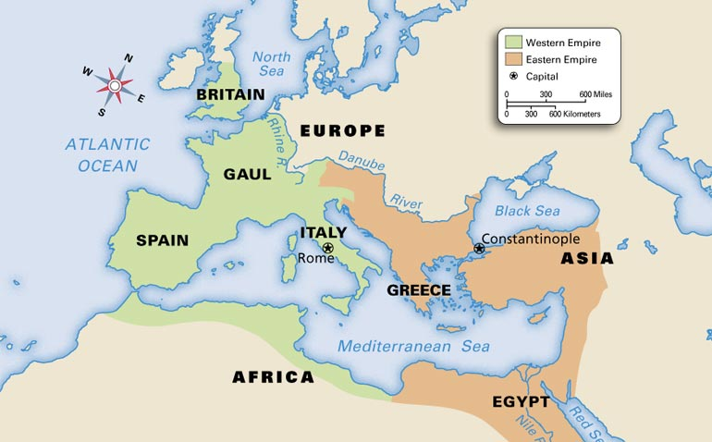
Diocletian: (dy-uh-KLEE-shuhn) (c. 245–c. 316) Roman emperor, he divided the Roman Empire into eastern and western halves.

Slide 4
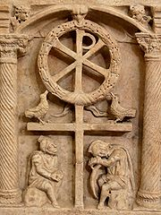
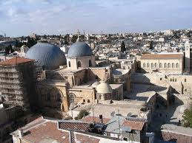
Constantine: (KAHN-stuhn-teen) (c. 280–337) Roman emperor, he was the first Roman emperor to become a Christian. Constantine moved the empire’s capital from Rome to Constantinople and removed bans on Christianity.

Slide 5
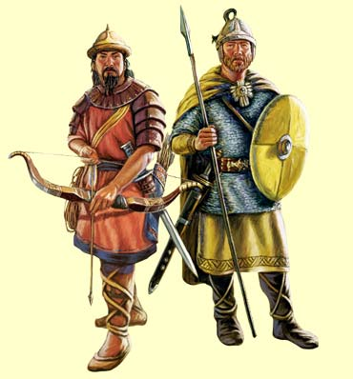
Clovis: (c. 466–511) King of the Franks, he was a Christian leader who was one of the most powerful rulers of the Germanic barbarians.
Attila: (AT-uhl-uh) (c. 406–453) Leader of the Huns, he led invasions of Constantinople, Greece, Gaul, and northern Italy and was greatly feared by the Romans.
corruption the decay of people’s values

Slide 6
Section 2
The Fall of the Western Roman Empire
Pg. 30

Slide 7
Main Ideas
1.Many problems threatened the Roman Empire, leading one emperor to divide it in half.
2.Barbarians invaded Rome in the 300s and 400s.
3.Many factors contributed to Rome’s fall.

Slide 8
CA Standards
7.1.2 Discuss the geographic borders of the empire at its height and the factors that threatened its territorial cohesion.

Slide 9
If YOU were there...
You are a former Roman soldier who has settled on lands in Gaul. In the last few months, groups of barbarians have been raiding local towns and burning farms. The commander of the local army garrison is an old friend, but he says he is short of loyal soldiers. Many troops have been called back to Rome. You don’t know when the next raid will come.
How will you defend your lands?

Slide 10
BUILDING BACKGROUND
Though the Roman Empire remained large and powerful, it faced serious threats from both outside and inside. Beyond the borders of the empire, many different groups of people were on the move. They threatened the peace in Rome’s provinces—and eventually attacked the heart of the empire itself.

Slide 11
Problems Threaten the Empire
At its height the Roman Empire included all the land around the Mediterranean Sea. The empire in the early 100s stretched from Britain south to Egypt, and from the Atlantic Ocean all the way to the Persian Gulf.
But the empire did not stay that large for long. By the end of the 100s emperors had given up some of the land the Roman army had conquered. These emperors feared that the empire had become too large to defend or govern efficiently. As later rulers discovered, these emperors were right.

Slide 12
Problems in the Empire
Even as emperors were giving up territory, new threats to the empire were appearing. Tribes of Germanic warriors, whom the Romans called barbarians, attacked Rome’s northern borders. At the same time, Persian armies invaded in the east. The Romans defended themselves for 200 years, but only at great cost.

Slide 13
Cont.
The Romans struggled with problems within the empire as well. Because so many Romans were needed in the army, not enough people were left to farm. To grow enough food, the Romans invited Germanic farmers to grow crops on Roman lands. These farmers often came from the same tribes that threatened Rome’s borders. Over time, whole German communities had moved into the empire. They chose their own leaders and largely ignored the emperors, which caused problems for the Romans.
Other internal problems also threatened Rome’s survival. Disease swept through the empire, killing many people. The government increased taxes to pay for the defense of the empire. Desperate, the Romans looked for a strong emperor to solve their problems.

Slide 14
Division of the Empire
The emperor the Romans were looking for was Diocletian (dy-uh-KLEE-shuhn), who took power in the late 200s. Convinced that the empire was too big for one person to rule, Diocletian divided the empire. He ruled the eastern half of the empire and named a co-emperor to rule the west. Not long after Diocletian left power, Emperor Constantine (KAHN-stuhn-teen) reunited the two halves of the Roman Empire for a short time. Constantine also moved the empire’s capital to the east into what is now Turkey. He built a grand new capital city there. The new capital was called Constantinople (KAHN-stant-uhn-oh-puhl), which means “the city of Constantine.” Although the empire was still called the Roman Empire, Rome was no longer the real seat of power. Power had moved to the east.

Slide 15
Barbarians Invade Rome
Not long after Constantine moved Rome’s capital, German barbarians—people the Romans considered uncivilized—from the north began to raid the Roman Empire. As you have already read, barbarian tribes had settled along the empire’s northern border in the 200s. For more than 100 years these tribes mostly stayed out of Roman territory. Late in the 300s, though, the barbarians began raiding deep into the heart of the empire.

Slide 16
Early Invasions
The source of these raids was a new group of people who moved into Europe. Called the Huns, they were fierce warriors from Central Asia.
As you can see on the map on the next page, the Huns invaded southeastern Europe. From there they launched raids on nearby kingdoms. Among the victims of these raids were several groups of people called the Goths.

Slide 17
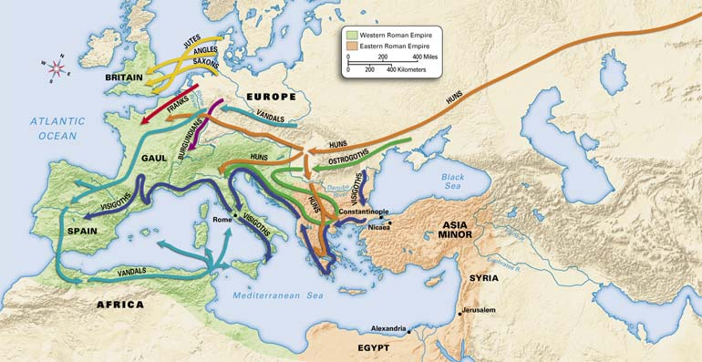
Invasions of the Roman Empire, 340–500

Slide 18
The Empire in Chaos
Unfortunately for Rome, the city’s fall to the Goths in 410 wasn’t the end of the invasions. The Gothic victory served as an example for other barbarian groups to invade the western half of the empire.
In the early 400s the Vandals invaded Spain. Then they crossed into northern Africa and destroyed Roman settlements there. As they passed through Roman areas, the Vandals destroyed nearly everything in their path. At about the same time, the Angles, Saxons, and Jutes invaded Britain, and the Franks invaded Gaul.

Slide 19
Cont.
By the 480s a Frankish king named Clovis had built a huge kingdom in Gaul. Clovis, a Christian, was one of the most powerful of all the German kings. Meanwhile, the Huns, under a new leader named Attila (AT-uhl-uh), raided Roman territory in the east. Attila was a brilliant leader and a very scary enemy.

Slide 20
Cont.
Attila led the Huns in raids against Constantinople, Greece, Gaul, and parts of northern Italy. But because he was told that diseases ran wild in southern Italy, he decided not to go south to Rome.

Slide 21
The Goths and Huns were just two of the groups that invaded the Roman Empire. In this illustration, a Goth warrior is shown on the right, and a Hun is shown on the left. These invaders also battled each other, as Huns attacked Goths and fought for territory and riches.

Slide 22
Key Events in Roman History

Slide 23
Why Rome Fell
Problems Inside the Empire
Large size made communication difficult. Corruption became common. Rich citizens left Rome for country estates. Taxes and prices rose.
Problems Outside the Empire
Barbarians began invading the empire.

Slide 24
The End of the Western Empire
Rome needed strong leaders to survive these constant attacks, but the emperors of the 400s were weak. As attacks on Rome’s borders increased, military leaders took power away from the emperors. By the 450s military leaders ruled Rome.
Unfortunately for Rome, most of these military leaders were too busy fighting among themselves to protect the empire. Barbarian leaders took advantage of this situation and invaded Rome. In 476 a barbarian general overthrew the last emperor in Rome and named himself king of Italy. Many historians consider this event the end of the western Roman Empire.

Slide 25
Factors in Rome’s Fall
There were many causes for the decline of Rome, including barbarian invasions, corruption of governmental officials, inflation and a weakening economy, and the power of the military to make and remove emperors.
One cause of Rome’s decline was the vast size of the empire. In some ways, Rome had simply grown too big to govern. Communication among various parts of the empire was difficult, even in peaceful times. During times of conflict it became even more difficult.

Slide 26
Cont.
Political crises also contributed to the decline. By the 400s corruption, the decay of people’s values, had become widespread in Rome’s government. Corrupt officials used threats and bribery to achieve their goals, often ignoring the needs of Roman citizens. Because of officials like these, Rome’s government was no longer as efficient as it had been in the past. In the face of this corruption, many wealthy citizens fled the city of Rome for their country estates. This action created a series of causes and effects that further weakened the empire.

Slide 27
Cont.
Outside Rome, many landowners used slaves or serfs to work on their lands. To protect their estates and their wealth, many landowners created their own armies. Ambitious landowners used these personal armies to overthrow emperors and take power for themselves.
As wealthy citizens abandoned Rome and other cities, city life became more difficult for those who remained. Rome’s population decreased, and schools closed. At the same time taxes and prices soared, leaving more and more Romans poor. By the end of the 400s Rome was no longer the city it had once been. As it changed, the empire slowly collapsed around it.

Slide 28
SUMMARY AND PREVIEW
By the early 500s Rome no longer ruled western Europe. But as you will read in the next section, the empire in the east continued to prosper for several hundred years.

Slide 29
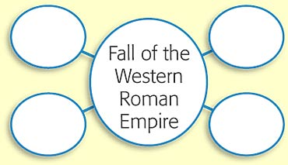
History Notebook pg. 6
In each of the outer circles, list a factor that helped lead to the fall of the western Roman Empire. You may add more circles if needed.

Slide 30
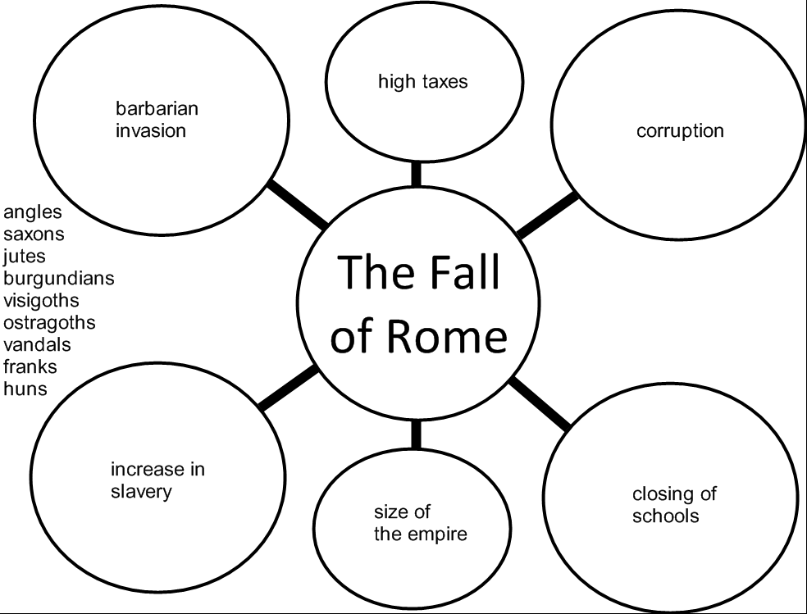
Chapter 2 Section 2 G.O.

Slide 31
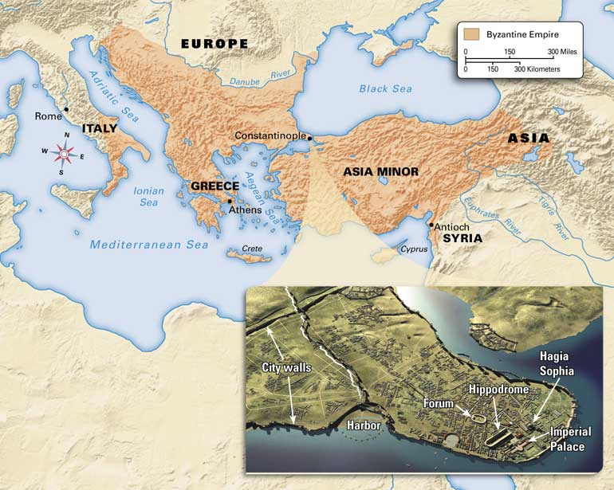
Section 3
The Byzantine Empire
Pg 36

Slide 32
Main Ideas
1.Eastern emperors ruled from Constantinople and tried but failed to reunite the whole Roman Empire.
2.The people of the eastern empire created a new society that was very different from society in the west.
3.Byzantine Christianity was different from religion in the west.

Slide 33
CA Standards
7.1.3 Describe the establishment by Constantine of the new capital in Constantinople and the development of the Byzantine Empire, with an emphasis on the consequences of the development of two distinct European civilizations, Eastern Orthodox and Roman Catholic, and their two distinct views on church-state relations.

Slide 34
If YOU were there...
You are a trader visiting Constantinople. You have traveled to many cities but have never seen anything so magnificent. The city has huge palaces and stadiums for horse races. In the city center you enter a church and stop, speechless with amazement. Above you is a vast, gold dome lit by hundreds of candles.
How does the city make you feel about its rulers?

Slide 35
BUILDING BACKGROUND
Even before the western empire fell to the Goths, power had begun to shift to the richer, more stable east. The people of the eastern empire considered themselves Romans, but their culture was very different from that of Rome itself.

Slide 36
Emperors Rule from Constantinople
Constantinople was built on the site of an ancient Greek trading city called Byzantium (buh-ZAN-shuhm). It lay near both the Black Sea and the Mediterranean Sea. This location between two seas protected the city from attack and let the city control trade between Europe and Asia. Constantinople was in an ideal place to grow in wealth and power.

Slide 37
Justinian
After Rome fell in 476, the emperors of the eastern Roman Empire dreamed of taking it back and reuniting the old Roman Empire. For Justinian (juh-STIN-ee-uhn), an emperor who ruled from 527 to 565, reuniting the empire was a passion. He couldn’t live with a Roman Empire that didn’t include the city of Rome, so he sent his army to retake Italy. In the end this army conquered not only Italy but also much land around the Mediterranean. Justinian’s other passions were the law and the church. He ordered officials to examine all of Rome’s laws and remove any out-of-date or unchristian laws.

Slide 38
Cont.
He then organized all the laws into a legal system called Justinian’s Code. By simplifying Roman law, this code helped guarantee fair treatment for all. Despite his achievements, Justinian made many enemies. Two groups of these enemies joined together and tried to overthrow him in 532. These groups led riots in the streets and set fire to buildings. Scared for his life, Justinian prepared to leave Constantinople.
Justinian was stopped from leaving by his wife, Theodora (thee-uh-DOHR-uh). She convinced Justinian to stay in the city. Smart and powerful, Theodora helped her husband rule effectively. With her advice, he found a way to end the riots. Justinian’s soldiers killed all the rioters—some 30,000 people—and saved the emperor’s throne.

Slide 40
The Empire after Justinian
After the death of Justinian in 565, the eastern empire began to decline. Faced with invasions by barbarians, Persians, and Muslims, later emperors lost all the land Justinian had gained. The eastern empire remained a major power for several hundred years, but it never regained its former strength.
The eastern empire’s struggles finally ended nearly 700 years after the death of Justinian. In 1453 a group called the Ottoman Turks captured Constantinople. With this defeat the 1,000-year history of the eastern Roman Empire came to an end.

Slide 41
A New Society
In many ways Justinian was the last Roman emperor of the eastern empire. After he died, non-Roman influences took hold throughout the empire. People began to speak Greek, the language of the eastern empire, rather than Latin. Scholars studied Greek, not Roman, philosophy. Gradually, the empire lost its ties to the old Roman Empire, and a new society developed.
The people who lived in this society never stopped thinking of themselves as Romans. But modern historians have given their society a new name. They call the society that developed in the eastern Roman Empire after the west fell the Byzantine (BI-zuhn-teen) Empire, named after the Greek town of Byzantium.

Slide 42
Outside Influence
One reason eastern and western Roman society was different was the Byzantines’ interaction with other groups. This interaction was largely a result of trade. Because Constantinople’s location was ideal for trading between Europe and Asia, it became the greatest trading city in Europe.
Merchants from all around Europe, Asia, and Africa traveled to Constantinople to trade. Over time Byzantine society began to reflect these outside influences as well as its Roman and Greek roots.

Slide 43
Government
The forms of government that developed in the eastern and western empires also created differences. Byzantine emperors had more power than western emperors did.
They liked to show off their great power. For example, people could not stand while they were in the presence of the eastern emperor. They had to crawl on their hands and knees to talk to him.
The power of an eastern emperor was greater, in part, because the emperor was considered the head of the church as well as the political ruler. The Byzantines thought the emperor had been chosen by God to lead both the empire and the church. In the west the emperor was limited to political power. Popes and bishops were the leaders of the church.

Slide 44
Byzantine Christianity
Byzantine Christianity
Just as it was in the west, Christianity was central to the Byzantines’ lives. From the beginning, nearly everyone who lived in the Byzantine Empire was Christian.
To show their devotion to God and the Christian Church, Byzantine artists created beautiful works of religious art. Among the grandest works were mosaics, pictures made with pieces of colored stone or glass. Some mosaics sparkled with gold, silver, and jewels.

Slide 45
Cont.
Even more magnificent than their mosaics were Byzantine churches, especially Hagia Sophia (HAH-juh soh-FEE-uh). Built by Justinian in the 530s, its huge domes rose high above Constantinople. According to legend, when Justinian saw the church he exclaimed in delight
“Glory to God who has judged me worthy of accomplishing such a work as this! O Solomon, I have outdone you!”
–Justinian, quoted in The Story of the Building of the Church of Santa Sophia

Slide 46
Cont.
As time passed, people in the east and west began to interpret and practice Christianity differently. For example, eastern priests could get married, while priests in the west could not. Religious services were performed in Greek in the east. In the west they were held in Latin.
For hundreds of years, church leaders from the east and west worked together peacefully despite their differences. However, the differences between their ideas continued to grow. In time the differences led to a split within the Christian Church. In the 1000s Christians in the east broke away from the rest of the church and formed what became known as the Eastern Orthodox Church. As a result, eastern and western Europe were completely divided

Slide 47
SUMMARY AND PREVIEW
The Roman Empire and the Christian Church both divided into two parts. The Eastern Orthodox Church became a major force in the Byzantine Empire. Before long, though, Orthodox Christians encountered members of a religious group they had never met before, the Muslims.

Slide 48
List what is different and what is the same with the two empires.
Western Roman Empire
Eastern Roman Empire

