Slide 1
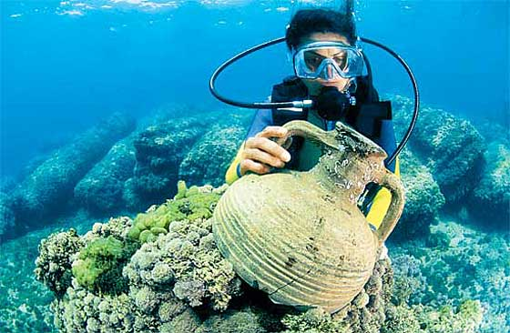
Ch. 1 Studying the Ancient World

Slide 2
What You Will Learn…
In this chapter you will learn how historians study the ancient world to unlock the mysteries of the past. In this photo a diver examines an ancient jar off the coast of Israel.

Slide 3
The Big Idea
Historians and archaeologists study fossils, artifacts, and written records to learn about the past.

Slide 4
The Main Ideas
1. Historians and archaeologists look for clues in written records and artifacts.
2. Other sources of clues include legends and luck.

Slide 5
Key Terms and People
Section 1
history
primary source
secondary source
archaeology
fossil
artifacts
Section 2
society
social structure
Cause
Effect
purpose

Slide 6
Ch. 1 Section 1
Clues from the Past

Slide 7
Ch. 1 Section 1 Clues from the Past
If YOU were there...
You are spending your summer helping scholars search for the tomb of a great king. Local legends tell that the tomb lies under a nearby hill, guarded by traps that will harm anyone who disturbs the king’s resting place. A single coin bearing the king’s name has been found at the hill. However, an ancient scroll says that the king’s body rests at the bottom of a deep lake, never to be found.
Should you continue to search for the tomb?

Slide 8
BUILDING BACKGROUND
The story of the past comes to us from many directions. What we hear, find, and read make up the pieces of a very big and fascinating puzzle.

Slide 9
Looking for Clues
The task before you seems simple. You must fit together the pieces of a jigsaw puzzle to create a picture. But what if most of the puzzle pieces are missing, and you don’t even know what the finished picture is supposed to look like?
This is the task that we may face when we try to learn about the past. To help us learn and to complete the picture, scholars from two basic fields work together like detectives.

Slide 10
What Historians Do
The main field that leads the investigation is history—the study of the past. History isn’t just about events that no one alive remembers. It is both the distant and recent past. A battle that happened 5,000 years ago and an election that happened yesterday are both part of history.
Historians are people who study history. Historians are very curious about the past. They want to know who did what. They want to know how, when, where, and why people did what they did.

Slide 11
Historians are interested in the way individuals lived. How did they work, fight, and worship? What did they do in their free time? Scholars also look at what groups of people have done. What may cause a nation to become powerful and then to fade away? Why did a new religion spread? What was the effect of an invasion?
To study the past, historians mainly use written works. In the 5,000 or so years that people have been writing, they have recorded laws, poems, speeches, battle plans, letters, contracts, and many other things. In these written sources, historians have found details about every aspect of human life. In addition, people have not been limited to paper and pens. They have carved messages onto stone pillars, stamped them into clay tablets, scribbled them on turtle shells, and typed them on computers.

Slide 12
Historical sources are of two types. A primary source is an account of an event created by someone who took part in or witnessed the event. Treaties, court records, and laws are primary sources. Diaries and letters are, too. An audio or video recording of an event is also a primary source.
A secondary source is information gathered by someone who did not take part in or witness an event. Examples include textbooks and encyclopedias. The book you are reading right now is a secondary source. The historians who wrote it did not take part in the events described. Instead, they gathered information about these events from different sources. However, if a historian writes an opinion about something, that opinion is a primary source. The opinion is a record of how a historian at a certain time viewed history and the world.

Slide 13
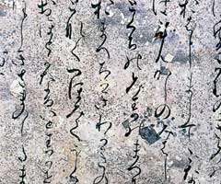
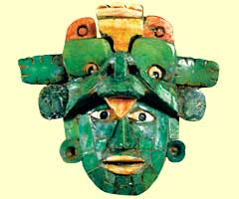
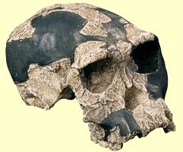
Written Records
Written records, like this Japanese writing from the 1000s, are a valuable source of information about the past.
Artifacts
The objects that people created and used, like this Maya mask, can tell historians about their culture, technology, and beliefs.
Fossils
The remains of early hominids can give us clues about their lifestyle. This skull from Africa is about 1.8 million years old.

Slide 14
What Archaeologists Do
Another field that contributes information about the past is archaeology (ahr-kee-AH-luh-jee). Archaeology is the study of the past based on materials that people have left behind. Archaeologists explore places where people once lived, worked, fought, hunted, or pursued other activities. In many cases, objects that people left behind at these places provide the only clues we have about their lives.

Slide 15
For information on the very first humans, archaeologists examine fossil remains. A fossil is a part or imprint of something that was once alive. Ancient bones and footprints preserved in rock are examples of fossils.
As human beings learned to make things, they also happened to create more sources of information for us. They made what we call artifacts, objects created and used by humans. Among the many types of artifacts are arrowheads, coins, tools, toys, jewelry, and pottery.

Slide 16
Although individual artifacts can give us useful clues, more useful are groups of artifacts from the same area and time period. Archaeologists refer to these collections of related artifacts as a group’s material culture. Just as important as the artifacts themselves are the places where they are found. For example, Viking coins and swords found in Russia can show that the Vikings traded and fought there.

Slide 17
Comparing
How are the fields of history and archaeology similar?

Slide 18
Other Sources of Clues
Historians and archaeologists work together. Archaeologists use written sources to help them find sites where they will find artifacts. Similarly, historians examine material culture to help them understand what they read. Sometimes these scholars also get help from sources that may surprise you.

Slide 19
Legends
Stories and legends can point scholars toward discoveries. For example, you have probably read stories about King Arthur. Historians know that no such king really lived during the Middle Ages.

Slide 20
However, legends about Arthur encouraged historians to search ancient documents for information about England’s distant past. In these sources historians found a warrior who lived in about AD 500. This man may have inspired the legends. Archaeologists, too, used the stories about Arthur as guides to make important discoveries.
Legends are still providing exciting clues that may lead to astonishing finds. For example, researchers in many fields are using legends about the burial of Genghis Khan, a mighty conqueror and ruler, to search for his tomb in his homeland of Mongolia. Archaeologists have found artifacts that suggest they are close to a major discovery, but so far Genghis Khan’s tomb has not been found.

Slide 21
Luck
Sometimes luck can play a major part in uncovering history. In 1974 Chinese farmers were digging a well. When their shovels hit hard clay instead of dirt, they were amazed to find the first of the clay soldiers you saw on the previous page.
One day, perhaps you will make an amazing discovery or uncover new information that will explain what happened long ago. Perhaps you will even solve one of history’s mysteries.

Slide 22
Evaluating
Do you think that legends and luck are reliable sources of clues? Why or why not?

Slide 23
SUMMARY AND PREVIEW
Historians and archaeologists use clues from many sources to learn about the past. Next, you will learn about some of the things they can discover by using these clues.

Slide 24
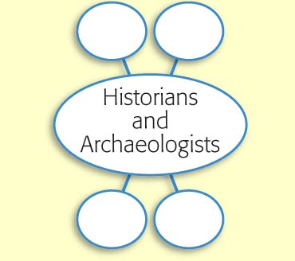
Use the interactive graphic organizer. In the empty circles, list the types of clues that historians and archaeologists use.

Slide 25
Ch. 1 Section 2
Putting the Pieces Together

Slide 26
The Big Idea
Historians and archaeologists put written and unwritten clues together to learn about the past and sometimes to revise their ideas about the past.

Slide 27
The Main Ideas
1. Using the evidence they have gathered allows historians to draw conclusions about societies in the past.
2. Views of the past change because of new discoveries and new interpretations.

Slide 28
Key Terms and People
Section 1
history
primary source
secondary source
archaeology
fossil
artifacts
Section 2
society
social structure
Cause
Effect
purpose

Slide 29
Key Terms
society
social structure

Slide 30
If YOU were there...
You are an expert on an ancient Asian language. For years you have worked at translating a long poem from that language into English. Now it is finally finished! The poem seems to be just a group of fairy tales, but you suspect that you can find some real facts within the fantastic stories. You want to know about the people who told the tales as they sat around their campfires.

Slide 31
What else can you learn from these tales?

Slide 32
BUILDING BACKGROUND
The people who wrote down these stories didn’t know that they were telling later generations about themselves. Yet that is just what they did. These unknown people were creating evidence that we can use to understand the past.

Slide 33
Using the Evidence
Archaeologists, historians, and other experts ask questions about the past. Then they gather clues and put them together to reveal information about past societies. A society is a community of people who share a common culture.

Slide 34
Social Structure and Family Life
Families are an important part of a culture’s social structure—the way a society is organizeda society is organized. We often learn about family life and social structure in sources that are more about something else. For example, you may remember a work of literature called the Rig Veda from last year’s study of ancient India. This work of literature is mainly about religion. It also tells, however, that Indian society was strictly divided into classes. Another text from India, the Ramayana, tells us about marriage in early Indian society. In this story, Rama and his wife Sita face many dangers. In Sita’s constant loyalty, we see what the Indians considered to be a perfect wife.

Slide 35
Art can tell us about social structure and families, too. For example, Egyptian tomb paintings show the pharaoh at the top of Egyptian society and the other classes below him. Other paintings show the pharaoh at home with his wife and children. In these scenes we see the importance of family to the Egyptians.

Slide 36
Politics and Economic Systems
Ancient sources also inform historians about political and economic systems. Written sources can be especially useful for learning about politics, or government. For example, many speeches of politicians from ancient Athens have survived in written form. Today, we can read those speeches and see that the Athenians valued democracy and that politicians worked hard to protect people’s freedoms.
Some written sources are useful for answering questions about a society’s economic situation—the value of its goods and services. Many cultures left behind business records showing the value of different products. Other lists tell us how much workers were paid for various tasks.

Slide 37
Artifacts also offer clues. These items can tell us about economic systems. Archaeologists may find Roman coins in China and Chinese coins in Rome. If the coins are from the same time period, we can conclude that the Romans and Chinese were doing business at a certain time.
We may also find the actual items that people traded. Ancient North America provides an example. Centuries ago, people used a rock called obsidian (uhb-SI-dee-uhn) for making weapons. But few sources of obsidian existed. Archaeologists have found obsidian weapons hundreds of miles from the stone’s sources. Using this information, experts can calculate how far trade in the valuable rock extended.

Slide 38
Language
Learning about ancient languages can be especially difficult for historians. When scholars find a document in an unknown language, they don’t find a dictionary for that language right next to it!
Sometimes historians can use clues from known languages to understand old ones. The most famous example is the Rosetta Stone. Created in ancient Egypt, the Rosetta Stone shows the same message in Greek and in two types of Egyptian writing. Because scholars could read Greek, they were able to translate the Egyptian writing also. Since the early 1800s, when its secrets were unlocked, the Rosetta Stone has helped historians read many Egyptian texts. Some ancient languages, however, are still complete mysteries.

Slide 39
Art and Architecture
Looking at a society’s art can tell us more about a society than just what its people liked to draw or paint. One thing art may show us is religious beliefs. For example, you probably remember that archaeologists have found Egyptian tombs full of beautifully crafted furniture, jewelry, toys, and other everyday items. The fact that the Egyptians placed these goods in tombs shows they believed the person buried there would need them. From this evidence, we can conclude that the Egyptians believed in life after death.

Slide 40
Architecture provides more evidence about societies. Clues come from the number and types of buildings. For example, if archaeologists find many temples in the ruins of a small town, they can assume that religion was very important there. Or, if none of the houses in a place were fancier than others, they may figure that no one was much richer than anyone else.
The structure of the buildings themselves can reveal clues, too. If an ancient castle had thick stone walls, perhaps war was a problem, and the people needed walls as protection from enemies. The beautiful temples that the Greeks built show the importance of the Greek gods. Similarly, buildings made with rounded arches show us the Romans’ engineering talents.

Slide 41
Beliefs and Values
Finally, historians and archaeologists use many sources to interpret the beliefs and values of a society. Written sources like the teachings of Confucius tell us about the importance of the family to Chinese society.

Slide 42
The Code of Hammurabi tells us that the Babylonian ruler of long ago valued justice. Written speeches show that the early Romans thought highly of citizens who served the republic.
Unwritten sources also provide information. Greek statues of athletes and images of athletes on vases show the value that the Greeks placed on sports. Unwritten sources can be harder to interpret, however. Sometimes archaeologists find artifacts whose purpose is unclear. Often, experts think these unidentified objects are related to religious beliefs. Other experts disagree. To understand the cultures that created these mysterious objects, we must find more information.

Slide 43
Generalizing
What types of information can evidence reveal about past societies?

Slide 44
Views of the Past
Although we have evidence from many sources, our understanding of history changes. Archaeologists may find new clues that change what experts think about a society. In addition, changes in our own society may alter our ideas about history.

Slide 45
New Discoveries
New historical evidence can change our understanding of when events happened. In recent years, archaeologists have found extremely old human bones in Africa and the Americas. These remains may require the time lines of human development to be completely rewritten.
Another example comes from the bottom of the Mediterranean Sea. Wrecks of Roman trading ships were recently found far off the Mediterranean coast. Scholars had thought that early Roman traders sailed their ships close to the coast.
The new finding suggests that sailors could navigate the open waters earlier than experts had thought.

Slide 46
How we view a society can also change with new archaeological finds. Not long ago, historians thought the Maya of Central America were a peaceful people interested mainly in studying the stars and making art. When scholars figured out how to read more Maya writing, however, they found that Maya rulers often made war on their neighbors. Scholars also learned that Maya religion included cruel, bloody rituals.
New evidence can even shed new light on old stories. Heinrich Schliemann (SHLEE-mahn) and his search for the city of Troy serve as a good example. For centuries, people had read Homer’s tales about the Trojan War in the Iliad and the Odyssey. Most people assumed they were just stories. Schliemann, however, thought they described real events in a real place. After years of searching and digging, Schliemann found a whole civilization that no one knew had existed. He also found the site of Troy.

Slide 47
New Interpretations
Views of history also change depending on the time, place, and cultures within which historians live. The growth of democracy, the civil rights movement, and women’s movements have affected how we study history. In the United States, for example, we now realize that women played key roles in history. In the past their contributions received little attention, but today many historians study women in history—both as a large group and as individuals.
The attention historians have paid to rich and powerful people versus ordinary or poor people is another example of changing views. Once rich and powerful people got almost all of the attention in history books. Now historians also look at how ordinary people lived.

Slide 48
Personal opinions of historians can also affect their views of the past. Political opinions, for example, can make historians see past times in certain ways. Historians must always be careful not to let their personal biases affect their work.
As you study world history, think critically about what you learn, and be ready for change! Because new evidence can appear, and because our own culture shifts, a historian must keep an open mind. Consider new evidence carefully, and be prepared to revise your understanding of history.

Slide 49
SUMMARY AND PREVIEW
Artifacts and written evidence help archaeologists and historians study and reconsider many aspects of past societies. In the next chapter you will study what historians and other scholars have learned about the fall of the Roman Empire.

Slide 50
Identifying Cause and Effect Use the interactive graphic organizer to describe what we may learn about a culture after a historian figures out how to read an ancient language.

